Slide 1
Week 11
Security policy and governance, Compliance requirements

Slide 2
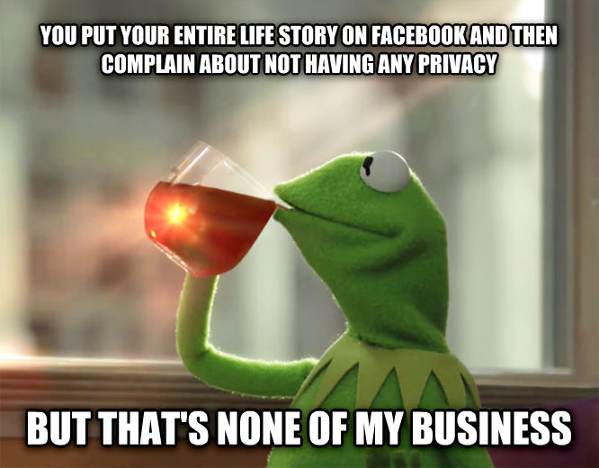
Privacy and Computers
Business
Databases
Social Media

Slide 3
Mass data privacy laws
Overview of Laws
M.G.L. 93H
  Defines Personal Information.
  Requires the state and affected parties be notified in the event of a security breach or unauthorized usage of personal information.
M.G.L. 93I
  Requires that personal information be destroyed in a manner that leaves it unrecoverable.
201 CMR 17.00
  Requires certain steps to verify that third party vendors with access to personal information do not introduce risk.
  Requires limiting the amount of personal information collected.
M.G.L. Ch. 93H defines Personal Information as an individual’s name in combination with any of the following:
  Social Security Number
  Driver’s License Number
  State Identification Card Number
  Financial Account Number, credit or debit card number
In addition, M.G.L. Ch. 93I includes Biometric Indicators as Personal Information.
https://malegislature.gov/Laws/GeneralLaws/PartI/TitleXV/Chapter93H

Slide 4
Organizations that protect privacy
Electronic Frontier Foundation (EFF)
  https://www.eff.org/
https://www.privacyguides.org/
In class activity!
  Everyone go to Privacy Guides and read about 1 thing of interest to you for 5 min and then share with the class what it was, why it’s interesting and what you are going to do with the information.

Slide 5
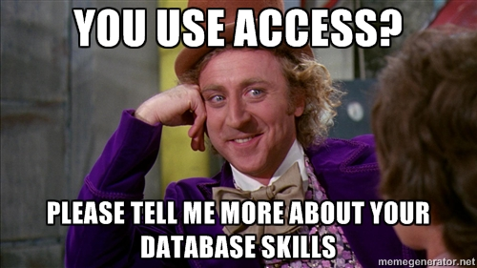
Databases
Inferring from multiple data items
Combining sources
What picture can we get from multiple sources and databases
Who gets access
Who gets control of database

Slide 6
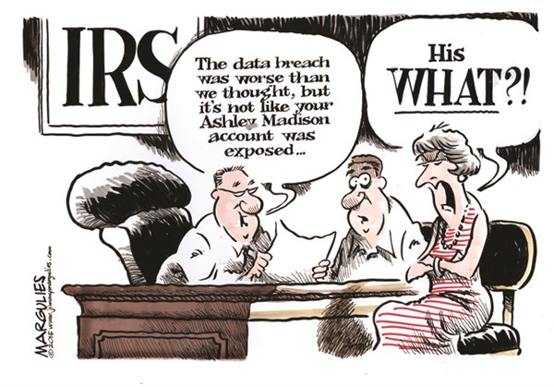
Data breaches
Yahoo
Equifax
TJ Maxx

Slide 7
Recent Breaches
PowerSchool (2024): data on about 62 million students and 9.5 million teachers. The hacker, a Massachusetts college student, was sentenced to 4 years in 2025
  Source: BleepingComputer
Canvas (2026): data on over 30 million students and staff stolen after voice phishing
  Source: TechCrunch

Slide 8
AI and Privacy Law
Companies want user data to train AI
In 2024, Ireland's Data Protection Commission got Meta to pause training AI on EU users' public posts
  Source: Data Protection Commission
Meta's use of AI chats for ads doesn't apply in the EU, UK, and South Korea, because of their privacy laws
The US has no federal privacy law requiring opt-in, so many companies make AI training opt-out

Slide 9
Data Backup Policies
What gets backed up?
What medium?
Where is it stored?
How often does the backup happen?
Is it encrypted?
What kind of backup is it?
What are your written policies and regulations?
How to review everything? And How often?

Slide 10
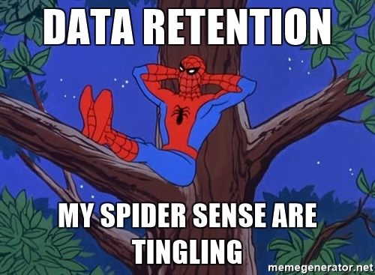
Data retention
What do you retain?
How long do you keep it?
What are your legal obligations?
  Compliance
What should you not retain?

Slide 11
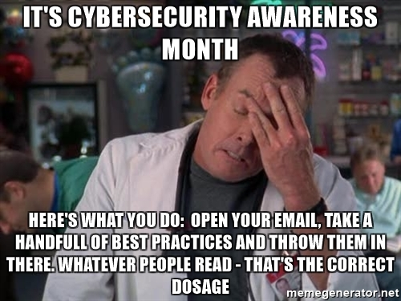
Breach reaction
Bad examples
  Basically everyone
Best practices
  PDF on Brightspace

Slide 12
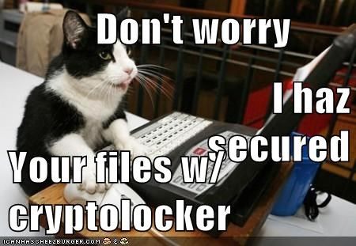
Threats
Insider Threats
Outsider Threats

